Slide 1
CASE 2 Experience of Housing
Group 6
Group 2
Group C
Notes:
Intended as a relatively “framework free” statement
Do we want to try to distinguish reflection & thinking / analysis / etc ? Simply describe reflection as type of thinking
Reflection is something we all do, to some extent, as part of our everyday lives – what we are concerned with here is structured reflection, as part of a process of learning an development in an educational or professional context

Slide 2

Introduction
Decision to set the questionnaire sample size to 100 by utilising statistical calculation based on Confidence Intervals.
Two sample groups of UK and Non-UK students
Based upon research from the Higher Education Statistics Agency (HESA), it was concluded to target 82 UK Students and 18 Non-UK students
Notes:
Intended as a relatively “framework free” statement
Do we want to try to distinguish reflection & thinking / analysis / etc ? Simply describe reflection as type of thinking
Reflection is something we all do, to some extent, as part of our everyday lives – what we are concerned with here is structured reflection, as part of a process of learning an development in an educational or professional context

Slide 3

Introduction
Interviews
Private rented accommodations at Strathclyde
Aspects Considered:
Landlords
Quality of Facilities
Safety and Security
Social Situation

Slide 4
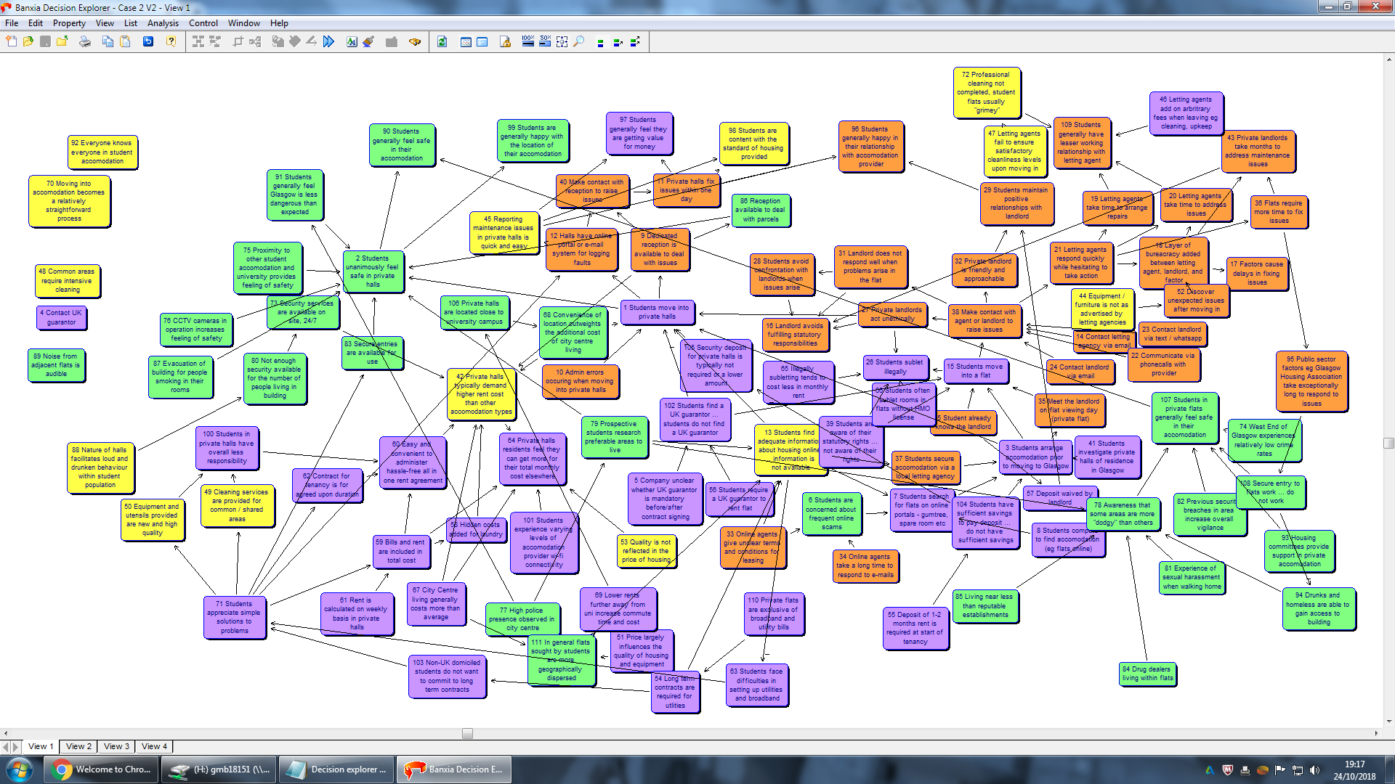
Introduction
Advantage
Method
useful to obtain detailed information and a broad range of information
save time and money
offer the opportunity to seek clarification
Cognitive map
Disadvantage
A cognitive map is a type of mental representation
Introduced by Edward Tolman in 1948
Widely used in the field of operations research
distract from the main focus
hard to control, manage and analyze
difficult to encourage a range of people to participate
participants may feel under pressure
may not be representative of non-users
Details
4 groups
6 to 8 people in each group
Record and transcribe
Focus Group
Notes:
Intended as a relatively “framework free” statement
Do we want to try to distinguish reflection & thinking / analysis / etc ? Simply describe reflection as type of thinking
Reflection is something we all do, to some extent, as part of our everyday lives – what we are concerned with here is structured reflection, as part of a process of learning an development in an educational or professional context

Slide 5
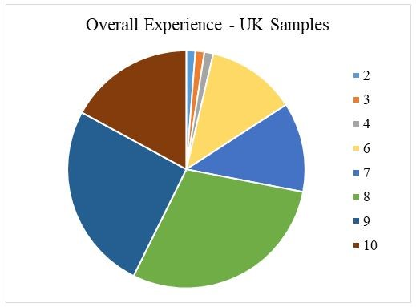
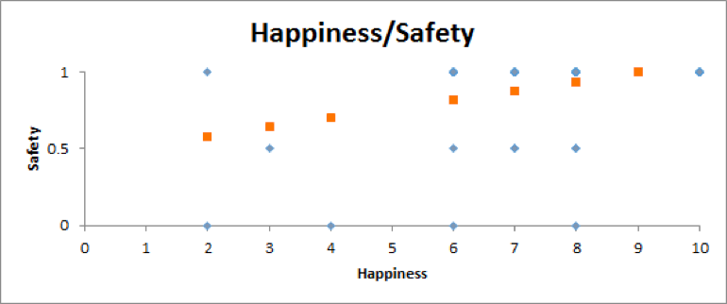
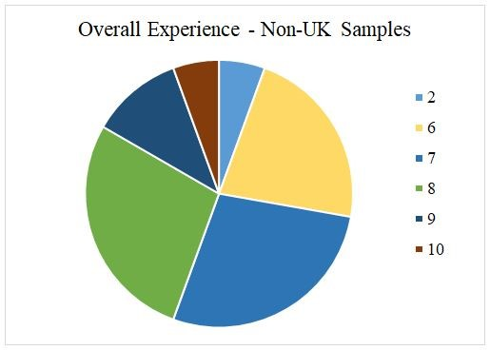
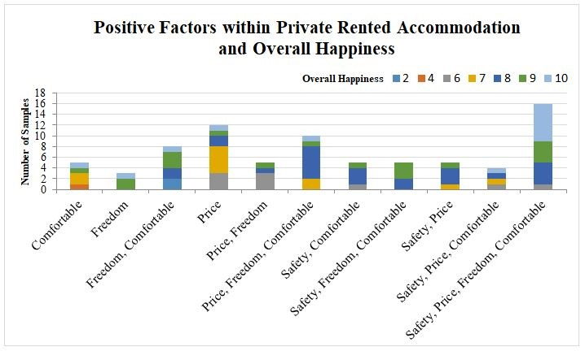
Experience
Y: | higher = feel safe living in the accommodation
X: | higher = happier
Looking at the regression model between the “Happiness” and “Safety” factors, they are having a positive relationship with one another.
Samples are found to be happier when they feel safe living in their accommodations.
A combination of being comfortable, satisfaction with price, the associated freedom and safety, are the most important factors for having a positive experience in the private rental sector
Disparity between nationalities ?
Notes:
Intended as a relatively “framework free” statement
Do we want to try to distinguish reflection & thinking / analysis / etc ? Simply describe reflection as type of thinking
Reflection is something we all do, to some extent, as part of our everyday lives – what we are concerned with here is structured reflection, as part of a process of learning an development in an educational or professional context

Slide 6
Experiences
Terrible flatmates, things broken too frequently and it’s noisy outside
Lots of experiences regarding different aspects of accommodation
Overall university experience is greatly influenced by issues surrounding accommodation
Got to know things about different cultures, instant socialisation with my flatmates and knowing that if something happens my flatmates will help.

Slide 7
Experience
Accommodation
Private flat
Easy communicate
Landlords
Host do not care the flat
Satisfied
Quality
Unexpected issues
More
Cost
Less
Safety
Location
Safety
Notes:
Intended as a relatively “framework free” statement
Do we want to try to distinguish reflection & thinking / analysis / etc ? Simply describe reflection as type of thinking
Reflection is something we all do, to some extent, as part of our everyday lives – what we are concerned with here is structured reflection, as part of a process of learning an development in an educational or professional context

Slide 8
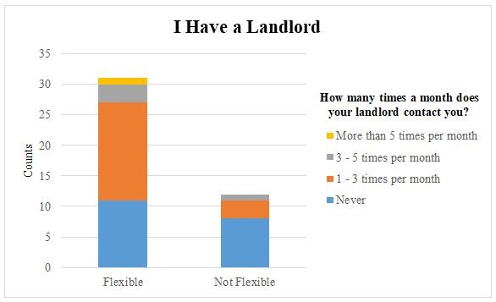
Landlords
52 out of 100 samples have a landlord, and most of them contact with their landlord 1-3 times a month.
Samples tend to have more “Excellent” experience dealing with the Landlord when they contact with their landlord only 1-3
Notes:
Intended as a relatively “framework free” statement
Do we want to try to distinguish reflection & thinking / analysis / etc ? Simply describe reflection as type of thinking
Reflection is something we all do, to some extent, as part of our everyday lives – what we are concerned with here is structured reflection, as part of a process of learning an development in an educational or professional context

Slide 9
Landlords
Make sure everything that landlord said is on the contract, agreed terms should be consistent with what is stated on contract.
Contractual Issues
67% of students had read contract before signing
22% did not sign a written contract
It’s the landlord’s responsibility to provide and replace agreed flat’s necessities. We have a good rapport and this is beneficial all the way. I get free stuff from her sometimes.
Communication
Nearly 90% believed communication was beneficial to a positive experience

Slide 10
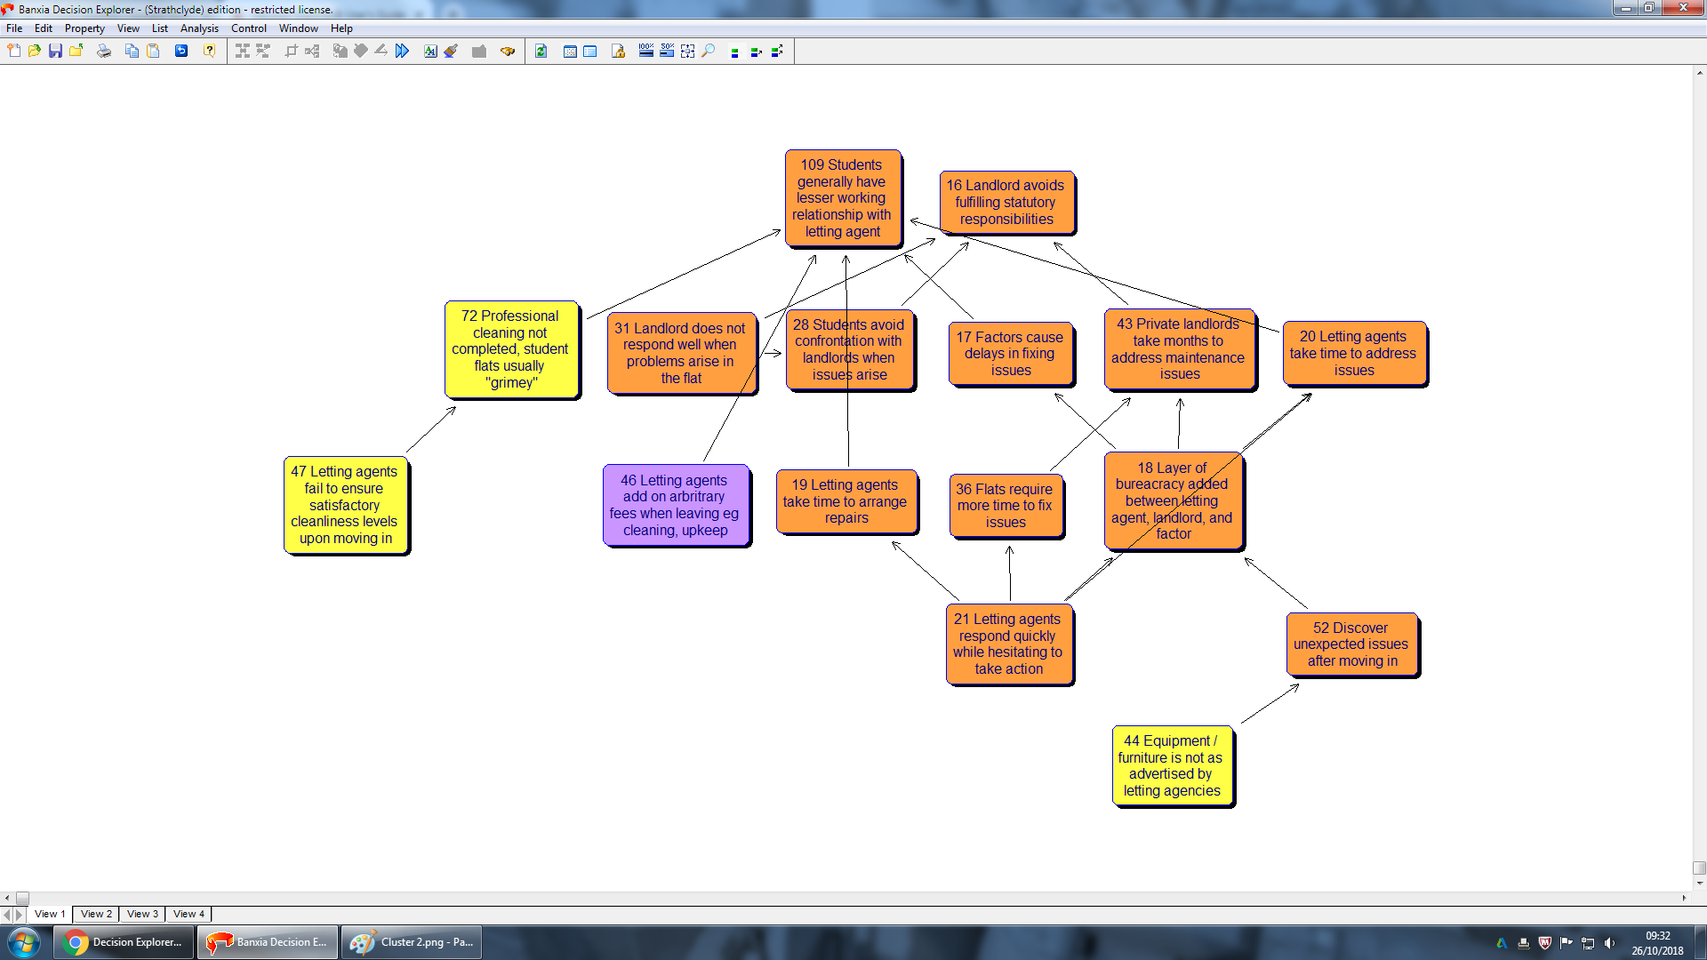
Landlords
01.Different
A significant contrast emerged between the type of relationship private student halls and private rented flats.
Question
How would you describe your relationship with your landlord, quick to respond to issues? Have you ever had a significant issue with your landlord?
02. Private halls
The participants described their relationship as very good
All issues are solved within the same day that the problem is reported
03. Private flats
The relationship can be friendly until issues start
Solving issues is not easy.
Notes:
Intended as a relatively “framework free” statement
Do we want to try to distinguish reflection & thinking / analysis / etc ? Simply describe reflection as type of thinking
Reflection is something we all do, to some extent, as part of our everyday lives – what we are concerned with here is structured reflection, as part of a process of learning an development in an educational or professional context

Slide 11
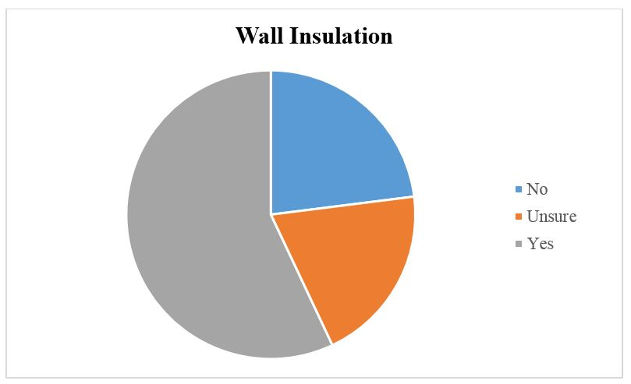
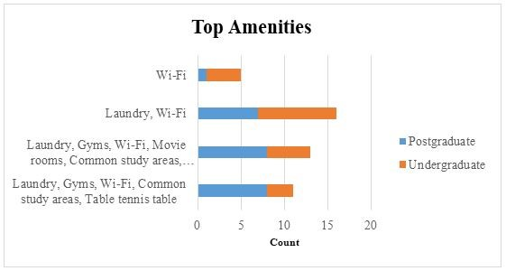
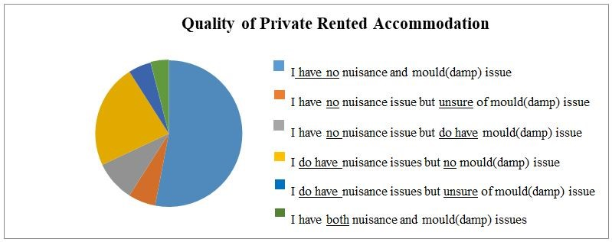
Disrepair / quality of housing
71 samples live in Flat/House-shares, and 47 of these have perceived this type of room to be spacious.
The chart depicted that the most fundamental amenities are “Laundry and Wi-fi".
Indicating that these two amenities are a must-have when considering/choosing private accommodation.
Notes:
Intended as a relatively “framework free” statement
Do we want to try to distinguish reflection & thinking / analysis / etc ? Simply describe reflection as type of thinking
Reflection is something we all do, to some extent, as part of our everyday lives – what we are concerned with here is structured reflection, as part of a process of learning an development in an educational or professional context

Slide 12
Quality and Maintenance of Housing
91 % were happy with condition of facilities and considered them “good”
85 % believed the building was well maintained
However some serious issues noted
Before coming here, I could only view the place from pictures posted on their website…The flat is so small, and the kitchen and common room is not the same as what was in the pictures… I have had numerous issues with the chairs, hoovers, microwave, boiler in the washroom and old wardrobes.

Slide 13


Disrepair / Quality of housing
Students living in private 'halls' are generally satisfied with the quality of their accommodation
Small issues with cleanliness and maintenance are solved quickly
The accommodation is in line with what was expected.
Students living in private flats experienced issues with properties not matching advertised descriptions.
Repairs took a long to be arranged.
Letting agents and landlords often charged a professional cleaning fee but the cleanliness of the property failed to be satisfactory.
Notes:
Intended as a relatively “framework free” statement
Do we want to try to distinguish reflection & thinking / analysis / etc ? Simply describe reflection as type of thinking
Reflection is something we all do, to some extent, as part of our everyday lives – what we are concerned with here is structured reflection, as part of a process of learning an development in an educational or professional context

Slide 14
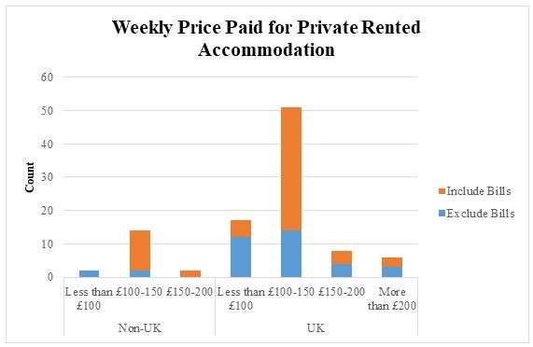
Cost including bills
Majority of both UK and Non-UK respondents paying between £100-£150
More than half of total respondents had their utility bills included in their rent
However, more concerted analysis revealed that while 73% of UK respondents opted for their total rent to include bills, the proportion was considerably higher for Non-UK (86%)
Notes:
Intended as a relatively “framework free” statement
Do we want to try to distinguish reflection & thinking / analysis / etc ? Simply describe reflection as type of thinking
Reflection is something we all do, to some extent, as part of our everyday lives – what we are concerned with here is structured reflection, as part of a process of learning an development in an educational or professional context

Slide 15
Cost
As if they are a family member, it has been a very good experience. I am very happy
Students in flats paid less compared to those in halls
Benefits for both types of accommodation
75 % believed they were getting good value for money
The flatmates are all nice, we did not have any conflicts until now. It is nearer to the campus compared to Andrew Ure Hall. And the corridors are also wider compared to private halls.
Good location in respect to the university, value for money (heating is included in the rent), room size (very spacious).

Slide 16


Cost including bills
Average cost for private 'halls' £451.57
Too expensive compared to private rentals
Paid for straightforward and simple process
Average cost for private rentals £366.36
UK guarnatoor often needed, difficult for many students
City centre locations more expensive.
Notes:
Intended as a relatively “framework free” statement
Do we want to try to distinguish reflection & thinking / analysis / etc ? Simply describe reflection as type of thinking
Reflection is something we all do, to some extent, as part of our everyday lives – what we are concerned with here is structured reflection, as part of a process of learning an development in an educational or professional context

Slide 17
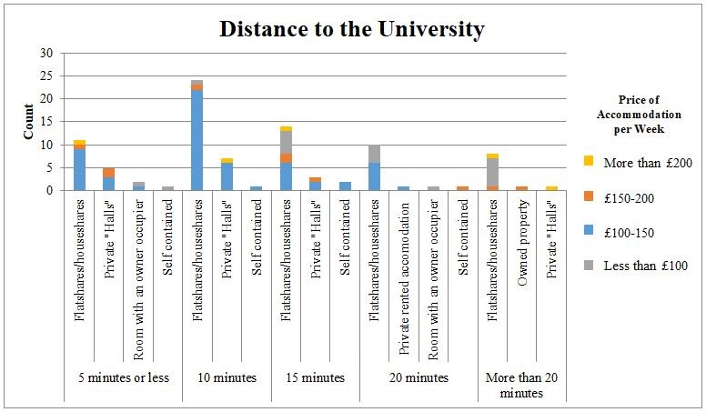
Location
26% of our sample is travelling for around 10 minutes from their accommodation to the university and are living in flat/house shares.
When price variable was introduced, data showed that majority of students paid between £100-£150 a week for accommodation, lived in a flat/house share and took roughly 10 minutes to travel to university.
Naturally, as time travelling increased, cost of accommodation decreased (inherent cost analysis?)
Notes:
Intended as a relatively “framework free” statement
Do we want to try to distinguish reflection & thinking / analysis / etc ? Simply describe reflection as type of thinking
Reflection is something we all do, to some extent, as part of our everyday lives – what we are concerned with here is structured reflection, as part of a process of learning an development in an educational or professional context

Slide 18
Location and Safety
…I feel a little bit unsafe. They provide us with the hall key, flat key and private room key, but for the hall entrance, strangers can easily sneak in if they follow a resident after he/she opens the doors. I once had that experience when a man followed me into the lift, I was scared by that time
Each correspondent lived in the Strathclyde area
50 % completely satisfied with security
Some safety and security concerns

Slide 19



Location and safety
Limited information on location to incoming students.
Private 'halls' often chosen due to convenient locations.
Students aware that some areas are more deprived than others.
Safety >> Location
High Police presence in city centre.
Students generally felt safe at their accommodation.
City centre was convenient.
Less time / money spent commuting to and from university.
Convenience outweighed lower rental costs.
Notes:
Intended as a relatively “framework free” statement
Do we want to try to distinguish reflection & thinking / analysis / etc ? Simply describe reflection as type of thinking
Reflection is something we all do, to some extent, as part of our everyday lives – what we are concerned with here is structured reflection, as part of a process of learning an development in an educational or professional context

Slide 20
Summary
Each method provided its own perspective on students' experience with private rental housing.
Students' staying in private halls generally experienced a greater quality of accommodation but paid more for this.
Safety was not uniformly recognised by all three methods but was prevalent in questionnaire and focus group respondents.
Recommendations
Notes:
Intended as a relatively “framework free” statement
Do we want to try to distinguish reflection & thinking / analysis / etc ? Simply describe reflection as type of thinking
Reflection is something we all do, to some extent, as part of our everyday lives – what we are concerned with here is structured reflection, as part of a process of learning an development in an educational or professional context

